Slide 1

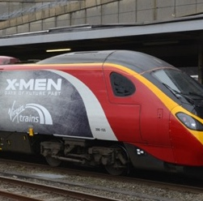



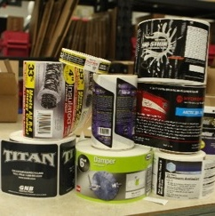

Print 4.0
Print is everywhere, and it’s going digital

Slide 2
Agenda
EFI intro
Fiery with FS400Pro
Automations in the Fiery Workflow Suite
Some advantages from EFI Fiery

Slide 3
About EFI
Technology company with over 30-years of printing industry innovation history
Connecting the online world to the physical world for industries that are rich
in images
Built on long-standing strategic partnerships
Over 3,000 team members; 1,000+ in R&D
Held by leading private equity firm Siris Capital Group

Slide 4
Today’s market challenges
Guarantee color accuracy & consistency
Managing multiple workflows
Keeping up with technology changes
Source:
North American Production Software Investment Outlook, InfoTrends, 2020
Expand to new customers or industries
Expand to new applications or services
Reduce production costs by improving efficiency
Dealing with high number of small jobs
Notes:
Do you currently…
Are you frustrated by these common pitfalls (obstacles)
Are you troubled
unnecessary click charges
Paper waste from incorrect output due to no visual previews
Unreliable color shifts between job runs
Missed opportunities – lack of differentiation, lack of offerings
Infotrends study
You deal with many small jobs
Minimize waste, satisfy customer needs with correct color reproduction

Slide 5

Fiery is built to face the challenges
Driver of the digital revolution
Built to expand and face your future
Committed
to innovation
Notes:
Fiery servers are built to face exactly these challenges.
For the past 30 years, EFI has pioneered the transformation from analog to digital printing
Fiery has been the driver of the digital revolution, built to expand and face your future needs, while simultaneously being committed to innovation.
Fiery servers is the key piece of the puzzle to a highly efficient and productive print site

Slide 6
Fiery innovates in the areas you care the most
Fiery® remains the worldwide market leader in digital front end (DFE) innovation
COLOR & IMAGING
PRODUCTIVITY
MANAGEMENT
CONNECTION
Delivers the best imaging technology with accurate and consistent color
Provides performance
and automated workflows that maximize printer throughput
Enables profitable production of high-value products through leading job prep and management
Offers versatility
to fit in any environment with reliable system operation
Notes:
For the past 30 years, EFI Fiery technology has led the digital printing industry in providing innovation in the areas you care the most, the color, productivity, management, and connection that commercial and in-plant print shops need.
Fiery servers are the most innovative, scalable, and integrated solution to give customers the most from their print engines and deliver the highest return on their investment. The Fiery server value proposition is segmented in the following four areas of leadership.
Color & Imaging
Fiery servers deliver accurate, consistent color, and exceptional image quality.
Uncompromising color with Out-of-the-Box color and tools for expert interaction.
Productivity
The fastest RIP in the industry.
Fiery servers maximize productivity and automate workflows.
Management
The best and easiest-to-use tools on the market.
Produce finished jobs simply and quickly.
Connection
Robust tools to integrate Fiery servers into any workflow or environment.
Each of these areas are supported by a robust and unique feature set to guarantee these value statements.
For detailed information on each feature refer to the FS400 Pro Product Guide.
Standard and optional features vary by product.
Refer to the Fiery Feature Matrix or datasheet for the list of features included in Fiery products.

Slide 7
The Fiery foundation
Built for your business success and future needs
USER-CENTERED
RELIABLE
SCALABLE
COMPATIBLE
SECURE
A user community and a commitment to an intuitive, integrated user experience.
Made for demanding print environments with high uptime requirements.
Ready for your future needs. Fiery functionality grows as your business changes.
  Interoperability and integration to adapt to different environments and avoid workflow silos.
Stay up to date
with security requirements and standards that meet your specific needs.
Notes:
Many of the features in the system software strengthen the Fiery foundational areas. Which are those core values that make Fiery a solid choice to ensure return on investment for the entire solution.
User-centered: A user community and a commitment to an intuitive, integrated user experience
Reliable: Made for demanding print environments with high uptime requirements
Scalable: Ready for your future needs. Fiery functionality grows as your business changes
Compatible: Interoperability and integration to adapt to different environments and avoid workflow silos
Secure: Stay up to date with security requirements and standards that meet specific customer environments

Slide 8
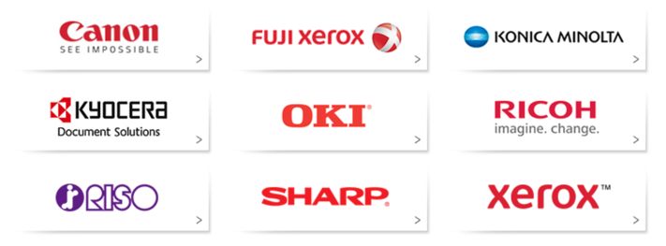
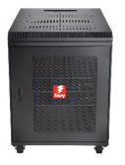
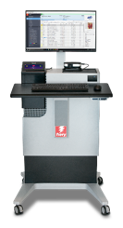
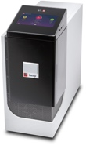
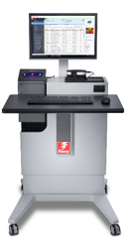
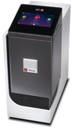
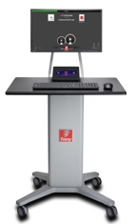



Fiery servers for all your printing needs
High-speed Inkjet
Commercial Printers
Fiery XB
Digital Printers
Fiery NX Premium
Print for Pay
In-plant CRDs
Fiery NX Pro
Corporate
Departmental
Fiery
E Series
NX One
Fiery A Series
Productivity, Performance, and Volume
Notes:
You will find Fiery servers in a wide variety of shapes and sizes, working on a range of digital print engines.
The Fiery server is built to scale to your production needs whether it for for an office environment all the way to commercial printers and high-speed inkjet.

Slide 9
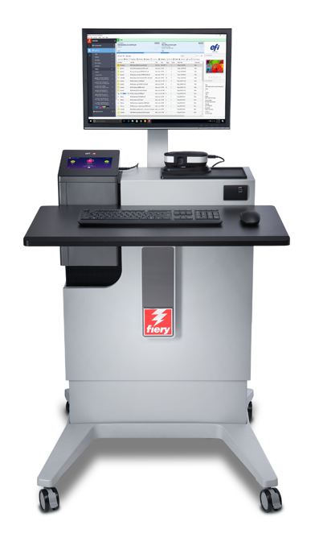
Exclusive Fiery server for your printer
Custom engineered to highlight each printer’s unique capabilities
Built to maximize printer’s capacity to run at full speed
Investment is safe with a Fiery server
Notes:
EFI understands print and every single Fiery server we release has been custom engineered to support the engine’s unique capabilities: from integrating with the engine’s media catalog, to supporting inline measuring devices, to compensating ink densities for a perfect output…
Fiery is built to feed the print engine in a way that it can maximize speed and capacity.
Custom servers provide a competitive advantage for each engine manufacturer, enabling them to bring unique value to the market.
This is what makes Fiery a safe investment for any given engine.

Slide 10



Fiery Workflow Suite
More than just a RIP, Fiery servers offer an integrated workflow from job submission to output
JOB SUBMISSION
PREPRESS
MAKEREADY
OUTPUT MANAGEMENT
PROCESSING
PRODUCTION DATA
COLOR
MIS SYSTEM
Notes:
In addition to driving digital presses, Fiery servers become a key component of your production workflow and offer a wide array of solutions that can effectively and efficiently streamline and automate your production processes from job submission to output.
Fiery® Workflow Suite is a comprehensive set of integrated products that enables you to produce more from your print engines with streamlined and automated workflows. Quickly adapt to changing customer demands, and grow with new higher-profit, value-added services.
There are solutions for every stage in the print production process. Modular offerings let you choose what you need now and add more as you grow. You can integrate current production systems by centralizing control of print job management to make existing print assets more scalable and productive. Plus, Fiery Workflow Suite products integrate with each other, with other EFI products, and with third-party solutions — for easy implementation, deployment, and use.
The remainder of the presentation is based in the value that Fiery brings to each stage of the print production process

Slide 11


Receive jobs from many sources
Fiery Command WorkStation
• Print driver
• Cloud
• Hot Folders
• Fiery JobFlow
• FTP
• USB
• 3rd Party prepress
workflows
• Email
EFI MarketDirect
StoreFront, Pace, MIS
• Smart phone
Notes:
Job Submission
Fiery server adapts to any print environment and can receive jobs from many sources. It is easy to send jobs from a web-to-print eCommerce solution, 3rd party workflows, FTP, Fiery JobFlow, cloud printing, email, smart phone USD, hot folders, virtual printers, print driver, and importing directly to Fiery Command WorkStation.
Fiery Driver: Provides a new printing interface that offers a simplified user interface that highlights basic printing options most commonly required in an office environment. This interface also caters to more advanced users because printing options are categorized based on a user-centric model. With the new Fiery Driver, features and functionality are consistent across different Windows operating systems, as well as in the Job Properties user interface.
Fiery Driver Configurator: Enables customization of the Fiery print driver to improve user experience and reduce print cost.
Fiery Command WorkStation: Guarantees user interface consistency in all instances where users need to set job attributes. Users now need to learn just one user interface to set up and submit jobs.
Microsoft® Office® filters for Hot Folders: Filters allow users to submit Microsoft Office documents to the Fiery using a drag-and-drop workflow onto the EFI Hot Folders utility. This functionality enables the users to submit jobs in native file formats directly to the Hot Folder, without the need to open and print the file from the native application.
USB Media Server: Fiery servers include USB to connect and print files stored on USB mass storage devices. New folders also can be created on the mass storage device for automated printing. Increases overall flexibility and facilitates walk-up users to easily print jobs at Fiery servers without FACI kit.
Fiery Direct Mobile Printing: Provides wireless printing for Apple mobile devices using the native iOS print function. Users do not have to use an app, and the list of available Fiery Driven printers automatically appears on the Apple device.
PrintMe® on Fiery Cloud Printing: Offers a real-time cloud printing solution that allows users to upload or email documents to the PrintMe Cloud service and release them to print from the printer control panel.
Server Job Presets: Saves commonly used job properties centrally, and shares them with all Fiery server users through all workflows. Automates selecting and using job properties for commonly used applications, saving time and maximizing productivity.
Fiery Hot Folder: Automates the print job submission process with a PC or Mac client tool and drag-and-drop functionality. Ideal for batch processing of multiple files with the same print settings. Filters allow users to route jobs to a print server with predetermined settings attached.
Fiery Virtual Printer: Automates the “File-Print” print submission process, saves time and increases productivity. Enables administrators to create a specific configuration for an output device and present it to users as a printer. Relieves users of the repetitive task of configuring print settings for multiple jobs.
Fiery JobFlow: Offers automated prepress processes that are easy to set up and use, minimizing rework and boosting overall efficiency on the print floor. Comes in two versions: JobFlow Base, a free version, and JobFlow, a paid version that provides additional functionality.
EFI MarketDirect StoreFront® Integration: Provides a scalable, Web-to-Print eCommerce solution. Includes a shopping cart, pricing options, approvals, job ticketing, tracking and status, an unlimited number of brandable storefronts, bidirectional integration to Fiery servers, and content and file management capabilities.

Slide 12

Automation for the highest efficiency
6 easy ways to add automation
6
Integration with business systems
5
Offline finishing automation
4
Fiery
JobFlow
3
New eBook!
Fiery
JobFlow Base *
Investment
2
Read now
Imposition automation
1
Hot Folders
and Presets *
* Standard on all Fiery external servers
Basic
Automation needs
Advanced
Notes:
There are many ways to automate, with options that scale to meet your needs. Start with the most basic with drag-and-drop functionality using Hot Folders and Presets, or driver-based automation using virtual printers. Integrate with Fiery Command WorkStation using presets. Then moved to the more sophisticated solutions with Fiery Impose, Fiery JobFlow and web-to-print submission using EFI MarketDirect StoreFront. And finally, there are solutions that can meet your advanced automation needs such as integration with offline finishers and business systems.
Cuts down on repetitive workflows for faster, error-free printing
Minimizes user errors
Shortens learning curves
Consistent across Mac and Windows® clients

Slide 13
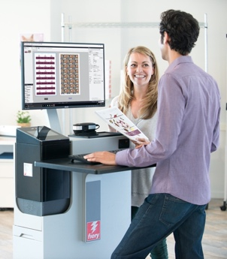




Automate imposition
Fiery Impose makes the page-layout process fast, intuitive and dependable
Automate workflows with customized templates
Optimize printable area with precise layout parameters
Honor trim and bleed values on PDF for accurate
trim mark placement
Use versatile gangup styles for efficient finishing and shipping of printed products
Produce saddle-stitched, nested saddle, or
perfect-bound booklets
Impose VDP jobs as easy as regular jobs
Business cards
Calendars
Personalized
postcards
Booklets
Notes:
Fiery Impose is a PDF imposition software that automates makeready tasks for unmatched efficiency in print production workflows.

Slide 14

Prepress
automation
Prepress automation
Perform essential job processing tasks to deliver ready-to-print files
Automate common job types to save time, and meet tight deadlines
SCALABLE
ADAPTABLE
EASY
Build easy-to-use prepress workflows to minimize touch points
Increase production capacity
Fiery JobFlow™ is a browser-based solution that automates repetitive manual job setup to produce ready-to-print files
Significantly reduce human errors in job setup
Watch Video
Notes:
A part of the Fiery Workflow Suite, Fiery JobFlow is a state-of-the-art prepress PDF workflow automation software that lets you submit jobs through Fiery Driven™ or Fiery Central print engines. It automates the prepress tasks in a print production workflow. Use it to build workflows that integrate powerful tools for PDF conversion, preflight checks, correction and editing of PDF files, image enhancement, image scaling, document imposition, internal and external approval, connection to third-party file processing solutions, and job ticketing.
Create a single workflow for a specific job type by arranging modules in the desired sequence to execute specific actions on the job file and use it repeatedly. Just create one for each of your most common job types and watch your productivity soar. You can create each workflow based on your specific needs. You can create as many workflows as you need, and vary the module configuration they use to process different types of jobs.
JobFlow helps not only eliminate repetitive manual setup, but also reduce the potential for errors. Download and install JobFlow from Fiery Software Manager. Then visit efi.com/jobflow to import ready-to-use workflows from our Fiery JobFlow Library, a repository for sample workflows that are preconfigured and fully functional.

Slide 15


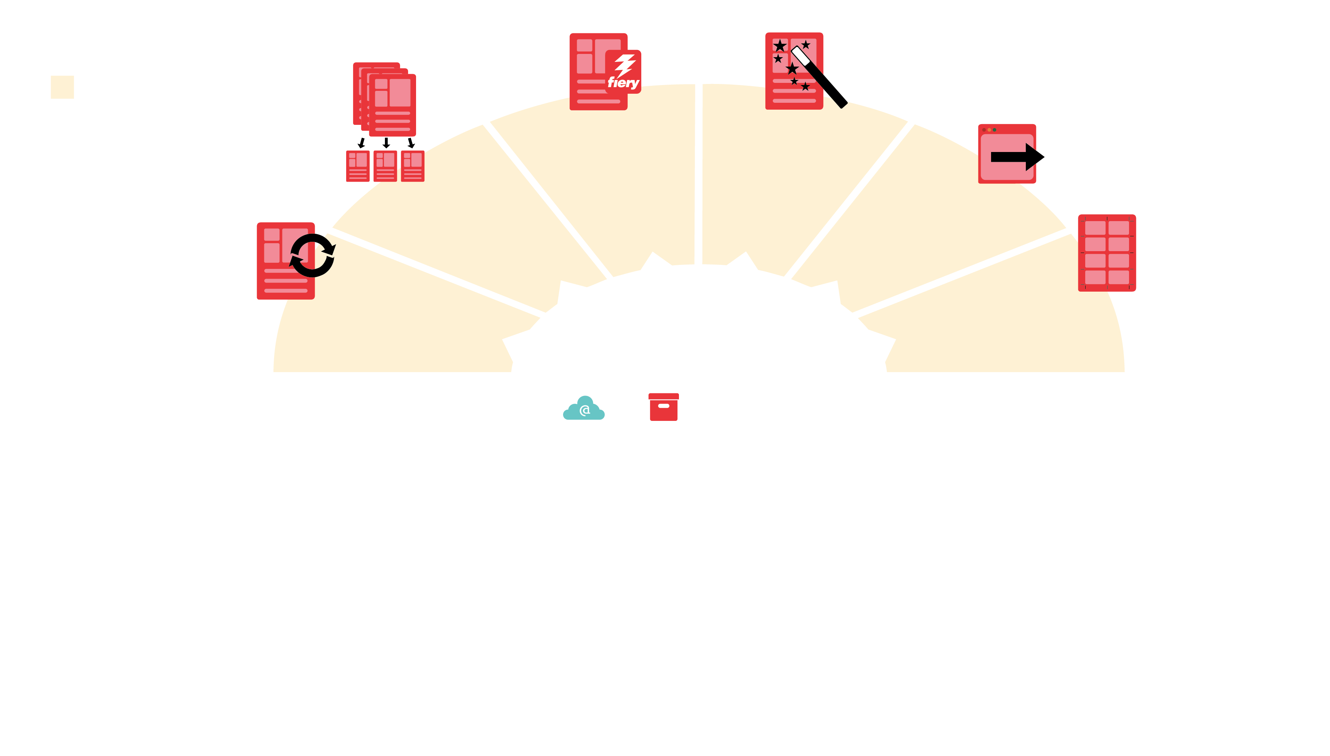
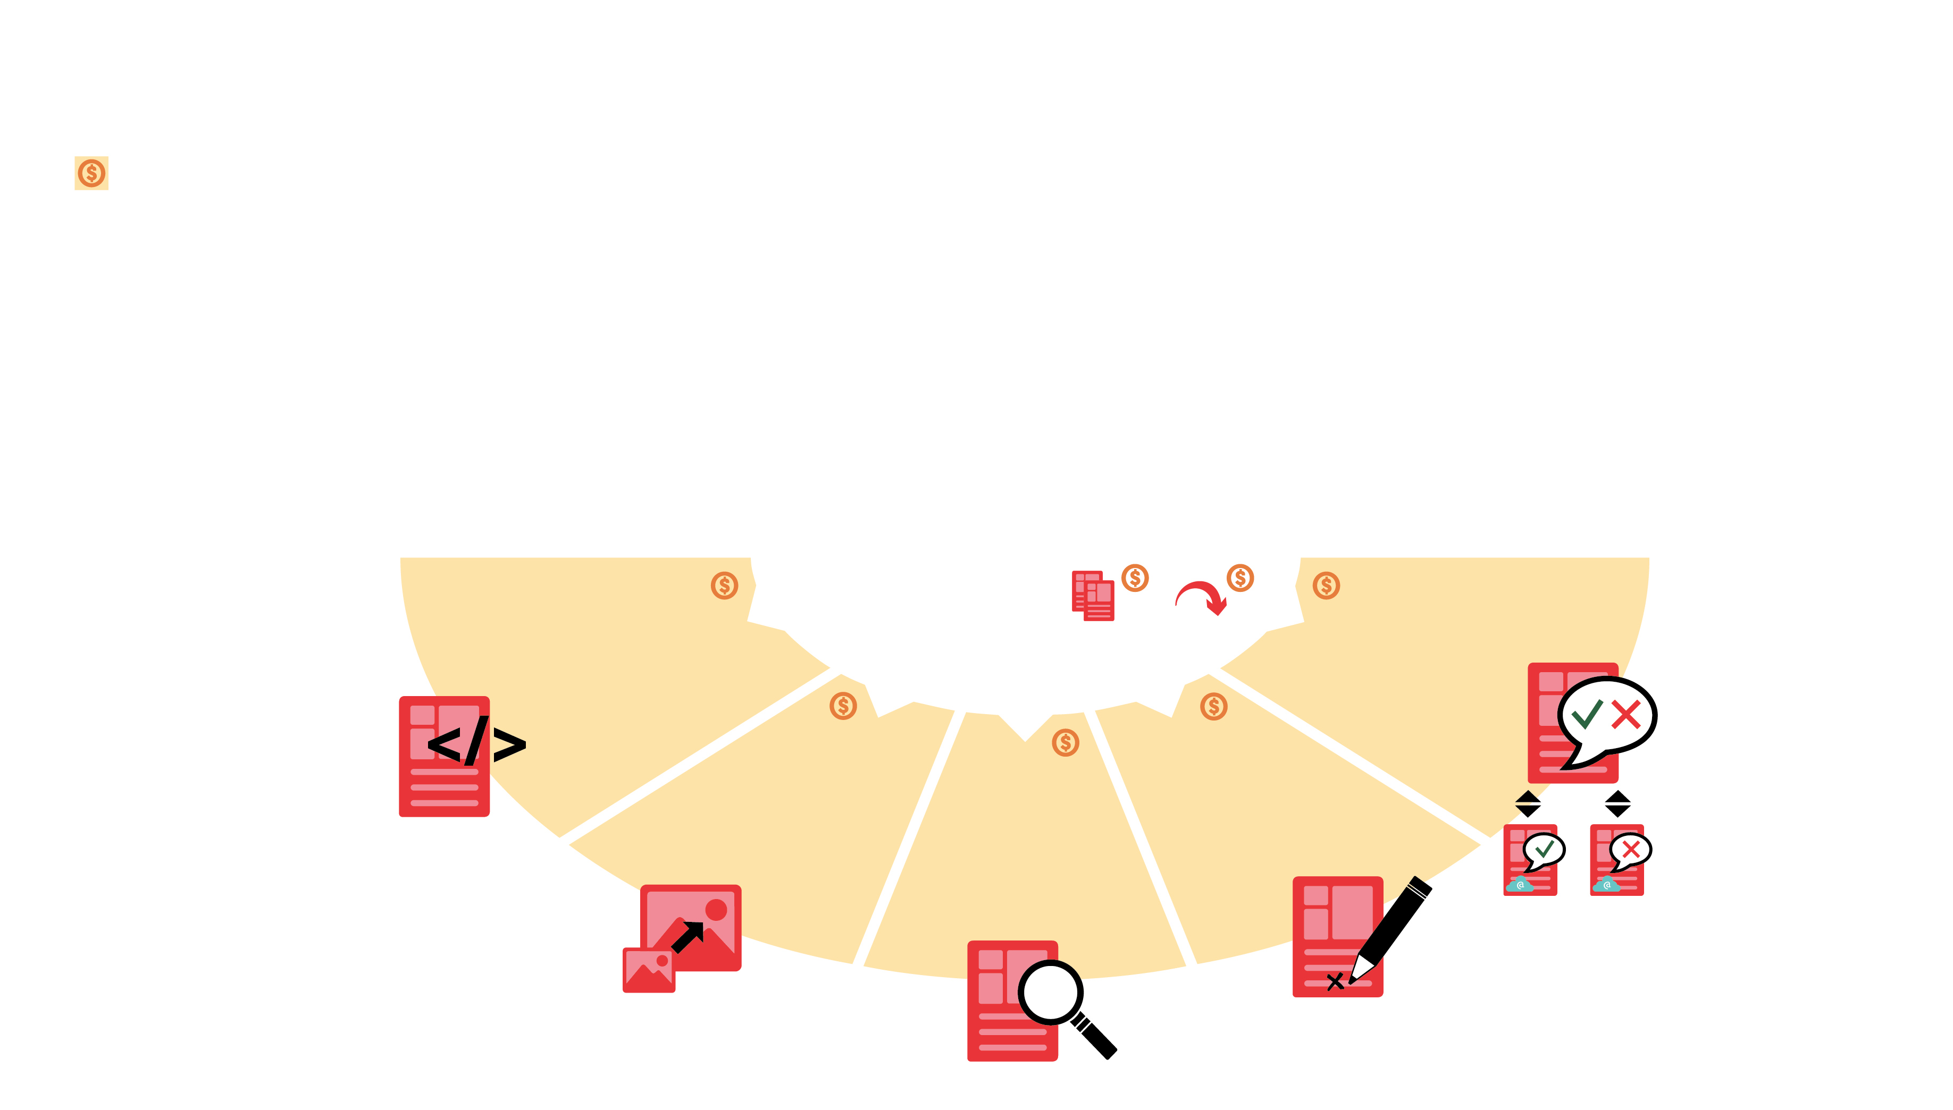
Don’t touch what you can automate
Prepress
automation
Fiery JobFlow Base (free)
Fiery JobFlow
FIERY
PREFLIGHT
IMAGE
ENHANCE
PRINTED
OUTPUT
PAGES
COLLECT
JOB
SUBMISSION
CONVERT
IMPOSE
CONFIGURABLE RULES
EFI MARKETDIRECT
STOREFRONT
CONNECT
eMail
Archive
Copy
Move
APPROVAL
AI IMAGE
SCALE
CORRECT
AUTOMATED FILE
MANAGEMENT
PREFLIGHT
Notes:
In this product diagram you can see the different modules and features in Fiery JobFlow.
JobFlow has two versions: Fiery JobFlow Base is the free version (depicted on top in lighter orange), and Fiery JobFlow a paid version (illustrated in darker orange) that provides additional functionality. Fiery JobFlow Base is comes pre-installed on external Fiery servers running on Fiery FS200 Pro and newer system software. Fiery JobFlow is also available for most embedded Fiery servers but requires a license for Fiery Automation Package or Fiery Productivity Package.
Use the free Fiery JobFlow Base version to:
• Perform essential job processing tasks such as image enhancement, imposition, and preflighting*
• Batch and collect jobs
• Submit files to the proper location or just drag and drop right on to the workflow
• Reorganize pages by splitting long jobs, or extracting pages
• Archive jobs at various processing stages for later reuse
• Receive email notifications on the job processing steps that are important to you
• Manage, import, and export workflows for maximum productivity and efficiency
(* Impose module requires Fiery Impose license. Fiery Preflight module requires Fiery Graphic Arts Package, Premium Edition/Fiery Graphic Arts Pro Package license for external Fiery servers, or Fiery Automation Package for embedded Fiery servers.)
Add additional automation functions with the paid Fiery JobFlow version to:
• Submit multiple jobs and intelligently route them to other workflows
• Allow external and internal reviewers to approve jobs remotely for uninterrupted workflow
• Inspect, troubleshoot, and correct jobs using Enfocus PitStop technology
• Use advanced scripting to incorporate job processing from third-party applications
• Use AI technology* to improve image resolution and DPI for printing images in lar ger sizes
• Automatically send jobs to the next available Fiery server
(* Requires purchase of API key from Let’s Enhance)

Slide 16








Automation from prepress to post-press
Integrate with all major offline slitter/cutter/creaser devices
Use templates and automate job preparation to guarantee your final products are produced accurately and efficiently
Prep jobs in just one click and save up to 70% in job setup time
Watch Video
Notes:
Automate slitter/cutter/creaser offline finishing with out-of-the-box Fiery Impose templates for top-selling finisher brands.

Slide 17





Use Fiery Edge profiles to get enhanced color and print quality
Fiery Edge
Fiery Edge™ profiling technology
• Take full advantage of each printer’s resolution, imaging, gamut, and media
• Use the Fiery Edge default profiles to get excellent out-of-the-box results
Fiery capabilities to produce the best:
Color
Image Definition
Detail
Improvements
Watch Video
Notes:
Fiery® Edge™ profiling technology takes full advantage of each printer’s resolution, imaging, gamut, and media capabilities to produce the best possible color, image definition, and detail improvements
Even better out-of-the box color and quality enhancements for Fiery servers that have Fiery Edge factory default profiles*
Get the very best from a printer’s capabilities
Smoother color transitions and blends
Enhanced shadow detail
Better blacks for more dynamic range
More image definition, depth, and clarity
Superior rendering of RGB images containing blues and reds
Support for up to 8 color channels

Slide 18






New controls for more appealing colors
More colorful, vivid, and high-contrast results
Maximize shadow details
Create smooth color-to-black transitions
Produce the best possible black and dynamic range
Fiery Intensify
Fiery Intensify
Fiery Intensify
Watch Video
Requires Fiery Color Profiler Suite
Notes:
Fiery Intensify is a new rendering intent innovation that is part of Fiery Edge profiling technology
It provides the ability to boost the color, saturation, and vividness of prints — while maintaining neutral grays and perfect skin tones
This is where color becomes smart, because the additional controls can intensify and give colors a pop without loosing detail and natural colors in skin tones, maintaining a pleasing look with smooth transitions, maintaining balance in grayscale elements

Slide 19





Cloud-based color process control
Calibration and verification scheduler
Notification
COLORGUARD
Analytics
Color compliance report
Watch Video
Notes:
EFI ColorGuard is a cloud-based color verification solution designed for print production managers.
Automate printer recalibration and color verification schedules
Receive notifications about color calibration and verification status
Alerts press operators to perform recalibration and color verification tasks
Tracks color quality trends

Slide 20

Optimize your production and quality processes
EFI IQ™ – A suite of cloud applications that makes print production more intelligent
Free apps
  IQ Dashboard
  EFI Insight*
  EFI Go
DASHBOARD
INSIGHT
GO
COLORGUARD
MANAGE
Watch Video
* EFI Insight is free for Fiery servers driving cutsheet printers
For Kyocera and RISO who have inkjet cutsheet printers, Insight is free. It just isn't free for Display Graphics.
Notes:
IQ is a gateway to smart print manufacturing. IQ gives visibility into print production. IQ analytics enable better and faster decision making. Seamless connectivity between applications and devices will spur collaboration among the team members.
The built-in applications will
1. Provide in-depth device information to increase operating efficiency
2. Provide game changing insights to take control on downtime and waste
3. Assist your print business to take smarter business operation decisions
4. Make print business more resilient to changing demands and conditions in the factory
5. Help you increase operation efficiency by performing predictive maintenance and manage supply chain

Slide 21


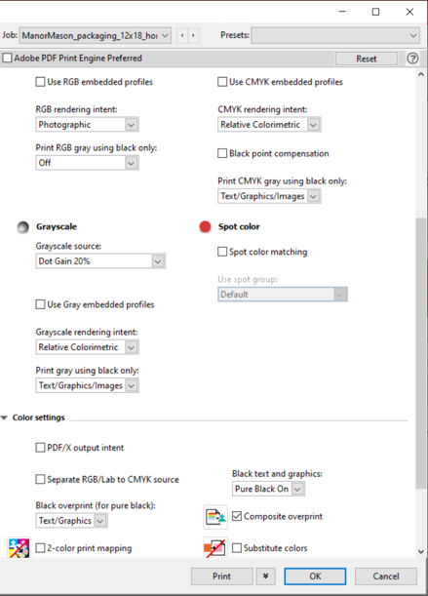


Perfect results can be daunting
Fiery Settings
30 settings

Slide 22



Fiery smart technology makes it happen
Wrong brand color
Transparency artifacts
Fiery
JobExpert™
One click
Wrong profile applied
Correct output with JobExpert
Watch Video
Available on new Fiery external servers running FS400 Pro software and above
Notes:
Fiery JobExpert is a breakthrough new technology that automatically chooses the optimal and most efficient way to process each job on the Fiery server to achieve the highest quality. It analyzes each PDF print job in detail and sets the best Fiery job settings for color management, image quality, VDP settings, and engine specific properties. Fiery JobExpert reduces setup time, enables faster processing, and cuts waste.
Standard feature on external Fiery FS400 Pro servers
Fiery JobExpert will analyze a PDF file and modify job properties to:
Correctly print transparencies and drop shadows
Accurately reproduce small text
Honor embedded profiles
Accurately reproduce ultra-thin lines and fine details
And much more!
Fiery JobExpert benefits:
Highest print quality
Faster processing
Enables less-experienced operators to run jobs correctly
Reduces setup time
Cuts waste

Slide 23

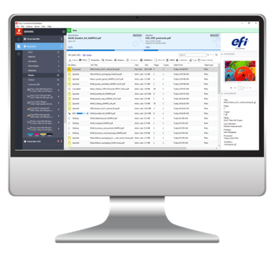
Unify your print job management
Fiery Command WorkStation
Connects to cutsheet, wide to superwide, and high-speed inkjet printers
Intuitive user interface –consistent across clients
Shortens operator training
Scalable functionality for varying skill levels
Achieves complex tasks with fewer clicks

Slide 24

Centralized job management
Makeready
Prioritization
Prepress
Finisher settings
Previews
Job submission
Color management
Print settings
Notes:
Manage multiple Fiery servers and manage jobs through one interface
Use integrated tools for seamless operation

Slide 25
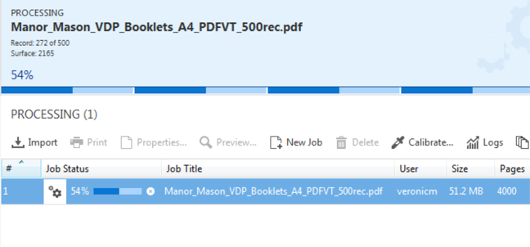
Process files faster and handle higher resolutions with ease
Fiery HyperRIP is a unique parallel processing technology that can increase RIP speed up to 55%
Up to 8 RIPs
Drive uninterrupted production and deliver jobs to your customers faster
Watch Video
Notes:
Fiery HyperRIP: Available on Fiery QX100 external DFEs, helps dramatically improve performance by simultaneously processing print jobs up to 55% faster by optimizing the use of the Fiery server’s interpreter and rendering engines across multiple processor cores. Fiery HyperRIP offers 2 modes of parallel job processing:
Single job
This is the traditional HyperRIP functionality introduced in Fiery FS100 Pro software. It allows the Fiery server to partition a single job into up to four logical parts for parallel processing of pages in that job. HyperRIP modes are server settings found in the Fiery Configure module under the RIP selection. The single-job mode is selected by default. If the server is primarily printing long jobs, this mode provides the best performance. Single job mode is ideal when printing long, multiple-page jobs because HyperRIP processes those jobs faster to make the Fiery server available to process upcoming jobs.
Multiple jobs
This new mode allows the server to RIP up to four jobs at the same time to print many jobs in the fastest possible time. The multiple jobs mode is ideal when dealing with numerous short jobs such as book covers or flyers, or when a long job is being processed while other shorter jobs need to start printing. Jobs processed in this mode will print in the order they finished RIPping, meaning that smaller or shorter jobs will print before longer or bigger ones. If maintaining the print job order is important, this mode is compatible with the Sequential Print feature that requires jobs to output in the same order they were submitted to the print queue. Sequential Print is a server setting that is enabled in the Fiery Configure module.
Some file formats are not supported under the multiple jobs mode and will be processed using a single RIP path. Those file formats are: PPML, VDP, VIPP, PCL and FreeForm.
Rush RIP: It works in combination with the Fiery HyperRIP multiple-jobs mode and offers the ability to immediately RIP a single job without interrupting other currently RIPping jobs. This happens when the first four Fiery RIPs are busy processing jobs. The Fiery server makes a fifth RIP available immediately upon request to process the rush job at the same time other jobs are processing.

Slide 26


Render PDFs correctly
Supports both Adobe Configurable
PostScript Interpreter (CPSI)
and Adobe® PDF Print Engine (APPE)
  Ensures consistent, predictable document production from design to printed output
  Yields dramatically faster processing speeds even for complex files
Notes:
Adobe® Configurable PostScript Interpreter (CPSI): Fiery servers pioneered digital workflows as a co-developer with Adobe Systems. The combined solutions continue to lead the industry with innovative technologies that ensure consistent, predictable document production. Today, Fiery servers include a PostScript interpreter (co-developed by Adobe and EFI) equivalent to Adobe Configurable PostScript Interpreter (CPSI 3017) that parses and rasterizes print jobs.
Adobe PDF Print Engine (APPE) Support: Integrates the APPE rendering technology to offer the option of a native PDF end-to-end workflow. Improves the consistency and flexibility of the printed output from design to output in digital and offset print solutions.
Adobe’s PDF-based RIP, Adobe PDF Print Engine (APPE), enables direct PDF RIPping without conversion to PostScript, avoiding potential errors for PDF files that contain transparencies.

Slide 27





Build custom solutions with Fiery API
Windows
Android
A popular RESTful style API that makes it easy to develop custom integration
Connect to Web/cloud services, homegrown apps/systems
Develop tools for your specific needs
Visit developer.efi.com for more information
Web
iOS
Mac
Notes:
Fiery API: Allows customers to rapidly develop unique apps and tools that integrate with the Fiery server for specific business needs on a variety of desktop or mobile platforms, including Windows®, Mac OS, iOS and Android.
In addition to Fiery JDF, Fiery customers can now use Fiery API (Application Programming Interface) allowing them to easily interact with Fiery servers from their own custom workflow system. Often times, a customer's workflow is unique to their business. With Fiery API, customers can rapidly develop their unique connectivity, plug-ins, or entirely new applications interacting with Fiery servers for a web browser, Windows®, Mac®, Linux®, iOS®, Android®, and other platforms using their familiar programming languages and development tools. Built on modern web-based technologies such as WebSockets, the Fiery API enables live, bidirectional communication, and adheres to the REST architectural style that has become standard for today’s web API and is used by Google, Amazon, Facebook, Twitter and more — allowing developers to conduct API calls with simple HTTP methods.

Slide 28


Use JDF integration to third-party solutions
Establish more efficient and automated workflows and generate higher return on your investment
  Map job settings and configuration without costly operator intervention
  Automate finishing so perfect-bound or saddle-stitched documents are printed as ordered
  See real-time status of Fiery jobs and engine conditions
  Track consumable usage
Notes:
Fiery servers are the first digital front ends in the industry to earn the CIP4 job definition format (JDF) IDP-ICS certification. Because Fiery JDF and job messaging format (JMF) fully support the accessible and open JDF standards, Fiery servers are easier to integrate with JDF-enabled third-party solutions. This lets you establish more efficient and automated workflows and generate higher return on your investment.

Slide 29
Stay informed and be agile
Sales and training resources located at:
Learning@EFI​
EFI.com
  resources.efi.com/fiery
Certification
e-Learning courses
Express videos
How to guides
Instructor led classroom
Podcasts
Simulation learning
Webinars

Slide 30
Get sales and technical support
Worldwide Fiery Sales Development Managers and Technical Sales Specialists help to sell, service, and support EFI solutions
Notes:
Our worldwide Fiery Sales Development Managers and Technical Sales Specialists support our sales channels. They help partners to be successful in selling, servicing, and supporting EFI solutions.

Slide 31




Your host was Geert Lenvain
Digital Sales Specialist
Responsible for Fiery sales in Belgium/Eastern Europe
Middle East and Central/North Africa…
LinkedIn or via geert.lenvain@efi.com
Notes:
All of Easten Europe for EFI is from Russia (Moscow) to Turkey (Istanbul and Ankara).
I want to thank Alfa Digital and especially Mr. Marcovic for having this platform and be able to have an audience in Serbia.
I travel a lot and on the slide is an overview of my experiences.
Who could tell me when the airplane was not on time?

Slide 32
Hvala vam!
efi.com

